Slide 1

End of Year Performance Contract Report
January 1, 2023 – June 30, 2024

Slide 2
End-of-Year Report
Every year, the Department of Developmental Services tracks the performance of each Regional Center with respect to our Contract with the State of California.
The Regional Centers are required to present this information to the public in the form of both a written report (available on our website) and a public presentation.
Following our presentation today, our Board, stakeholders, and the general community are invited to provide feedback and commentary, which will be communicated back to the Department.

Slide 3
Demographics
During the reporting period(January 1, 2023 – June 30, 2024), we served a net 19,760 individuals.

Slide 4
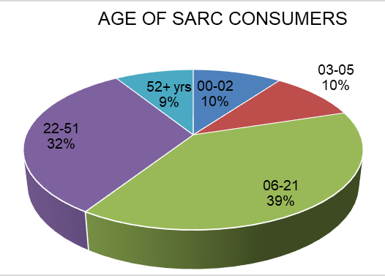

Slide 5
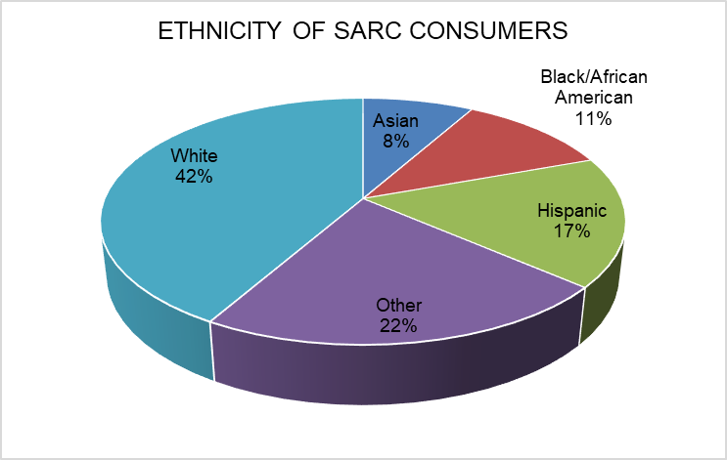

Slide 6
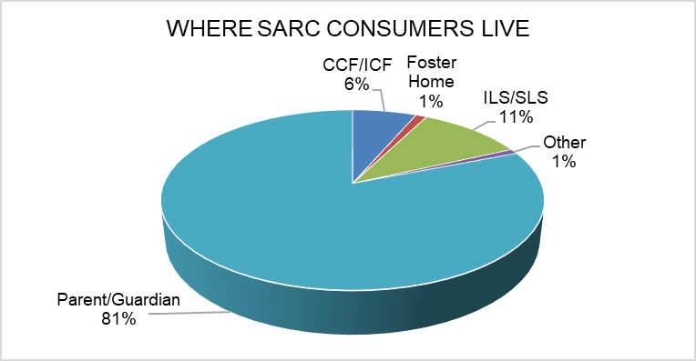

Slide 7
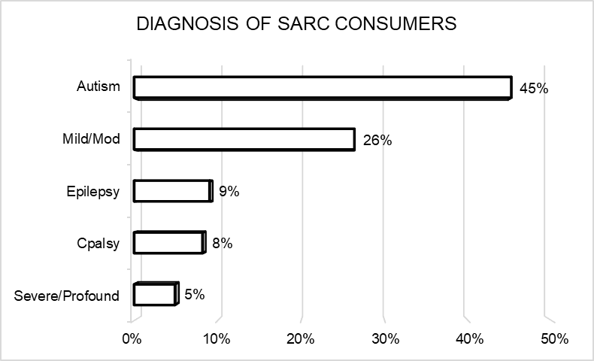

Slide 8
Performance Goals
A goal is met if the performance is better than the state average or the previous year.
Goal | Previous Avg | Last Report | Current Avg. | Current Report
Fewer individuals in developmental centers | 0.06% | 0.03% | 0.05% | 0.06%
More children live with families | 99.61% | 99.3% | 99.69% | 99.5%
More adults live in home settings. | 83.01% | 81.53% | 83.86% | 82.44%
Fewer children in large facilities | 0.03% | 0.00% | 0.02% | 0.00%
Fewer adults in large facilities | 1.67% | 1.58% | 1.46% | 1.38%

Slide 9
Compliance Standards
Standard | Last Report | Current Report
Pass independent audit | Yes | Yes
Pass DDS audit | Yes | Yes
Audit vendors | Yes | Partial*
Did not overspend operations budget | Yes | Yes
Participates in federal waiver | Yes | Yes
CDER/ESR updates | 96.25% | 99.99%
Intake/Assessment Timeliness | 97.79% | 99.67%
IPP requirements | 97.67% | 97.33%
IFSP requirements | 87.5% | 88.1%

Slide 10
Employment First: Highlights
13.74% of individuals served, ages 16-64, received earned income in 2023, up from 12.53% in 2022. (This number is tracked annually by the California Employment Development Department.)
Average annual wages of individuals served by San Andreas Regional Center in 2023: $15,140, versus a state average of $14,251
Number of adults served who were placed in competitive integrated employment after participating in the paid internship program: 78, an increase of 59 from previous year
Percentage of San Andreas Regional Center paid internship program participants who receive competitive integrated employment: 31% versus the state average of 10%

Slide 11
Reducing Disparities and Improving Equity
Individuals receiving case management only
Measure | Fiscal Year | Number of Eligible Consumers Receiving Case Management Only |  |  | Percent of Eligible Consumers Receiving Case Management Only
 |  | Birth to 2 | 3 to 21 | 22 and Older | Birth to 2 | 3 to 21 | 22 and Older
American Indian or Alaska Native | 21-22 | 1 | 1 | 4 | 100% | 50% | 17%
 | 22-23 | 0 | 2 | 3 | 0% | 67% | 14%
Asian | 21-22 | 55 | 677 | 202 | 9% | 32% | 14%
 | 22-23 | 33 | 549 | 224 | 5% | 26% | 14%
Black/African American | 21-22 | 1 | 54 | 30 | 14% | 43% | 11%
 | 22-23 | 1 | 43 | 41 | 17% | 39% | 15%
Hispanic | 21-22 | 274 | 1,102 | 329 | 12% | 31% | 13%
 | 22-23 | 223 | 1,016 | 357 | 8% | 27% | 13%
Native Hawaiian or Other Pacific Islander | 21-22 | 1 | 5 | 2 | 100% | 45% | 9%
 | 22-23 | 1 | 3 | 5 | 100% | 30% | 21%
White | 21-22 | 65 | 602 | 316 | 11% | 42% | 10%
 | 22-23 | 45 | 502 | 327 | 9% | 35% | 11%
Other Ethnicity or Race | 21-22 | 101 | 445 | 98 | 12% | 38% | 16%
 | 22-23 | 98 | 408 | 101 | 6% | 31% | 16%
Total | 21-22 | 498 | 2,886 | 981 | 12% | 34% | 12%
 | 22-23 | 401 | 2,523 | 1,058 | 7% | 29% | 13%

Slide 12
Reducing Disparities and Improving Equity:
Per capita purchase of service expenditures by primary language
Language | Consumer Count |  | Per Capita Purchase of Service Expenditures
 | 2021-22 | 2022-23 | 2021-22 | 2022-23
English | 13,721 | 15,446 | $28,588 | $30,434
Spanish | 4,836 | 5,246 | $11,735 | $12,371
Vietnamese | 987 | 965 | $17,818 | $19,708
Mandarin Chinese | 332 | 323 | $12,687 | $16,224
Tagalog | 135 | 128 | $25,302 | $31,269
Hindi (Northern India) | 118 | 92 | $11,733 | $17,122
All other languages | 108 | 64 | $10,745 | $16,126
Korean | 92 | 90 | $9,699 | $12,728
Cantonese Chinese | 85 | 79 | $27,316 | $35,207
Japanese | 47 | 51 | $12,720 | $13,191
Farsi (Persian) | 47 | 45 | $23,775 | $31,456
Russian | 45 | 33 | $21,525 | $35,675
Arabic | 37 | 36 | $11,407 | $14,542

Slide 13
Public Feedback
November 18th – 22nd
Jim Elliott, Compliance and Special Projects Manager
jelliott@sarc.org
sanandreasregional.org/contact-us/

